Slide 1
DEFORMITIES OF THE SPINE
BY: Dr. Bwana Ombachi
Lecturer
Consultant Spine and Orthopaedic Surgeon
DATE: 10/10/2016

Slide 2
OUTLINE
Definition
Pathophysiology
Classification
Natural History
Clinical Aspects of deformities

Slide 3
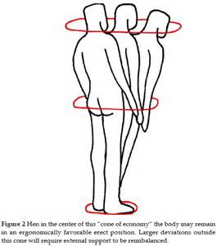
CONE OF ECONOMY

Slide 4
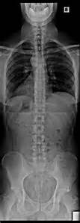
CORONAL BALANCE

Slide 5
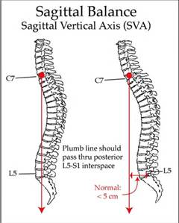
SAGITTAL BALANCE
Notes:
A line through the center of C7, bisects the space between L5, S1 vertebrae.

Slide 6
SPINAL DEFORMITIES
Apparent
Coronal plane → Scoliosis
Saggital plane → Kyphosis/ Lordosis
Spinal deformities are usually triplanar i.e.,
Coronal component
Saggital component
Rotational component
They are usually → Three Dimensional Deformities.

Slide 7
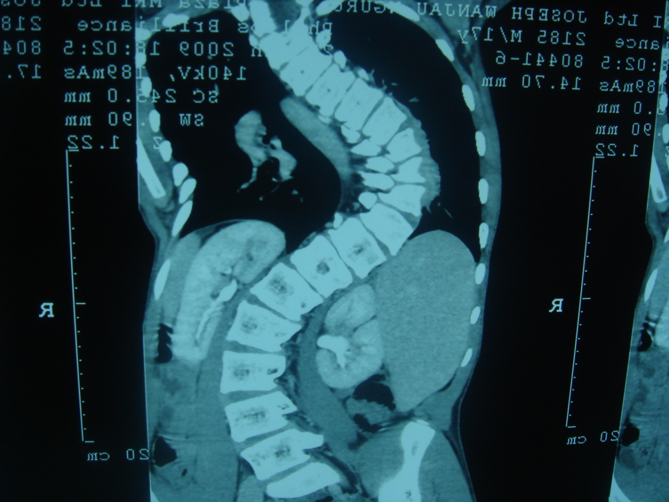
CORONAL PLANE DEFORMITY

Slide 8
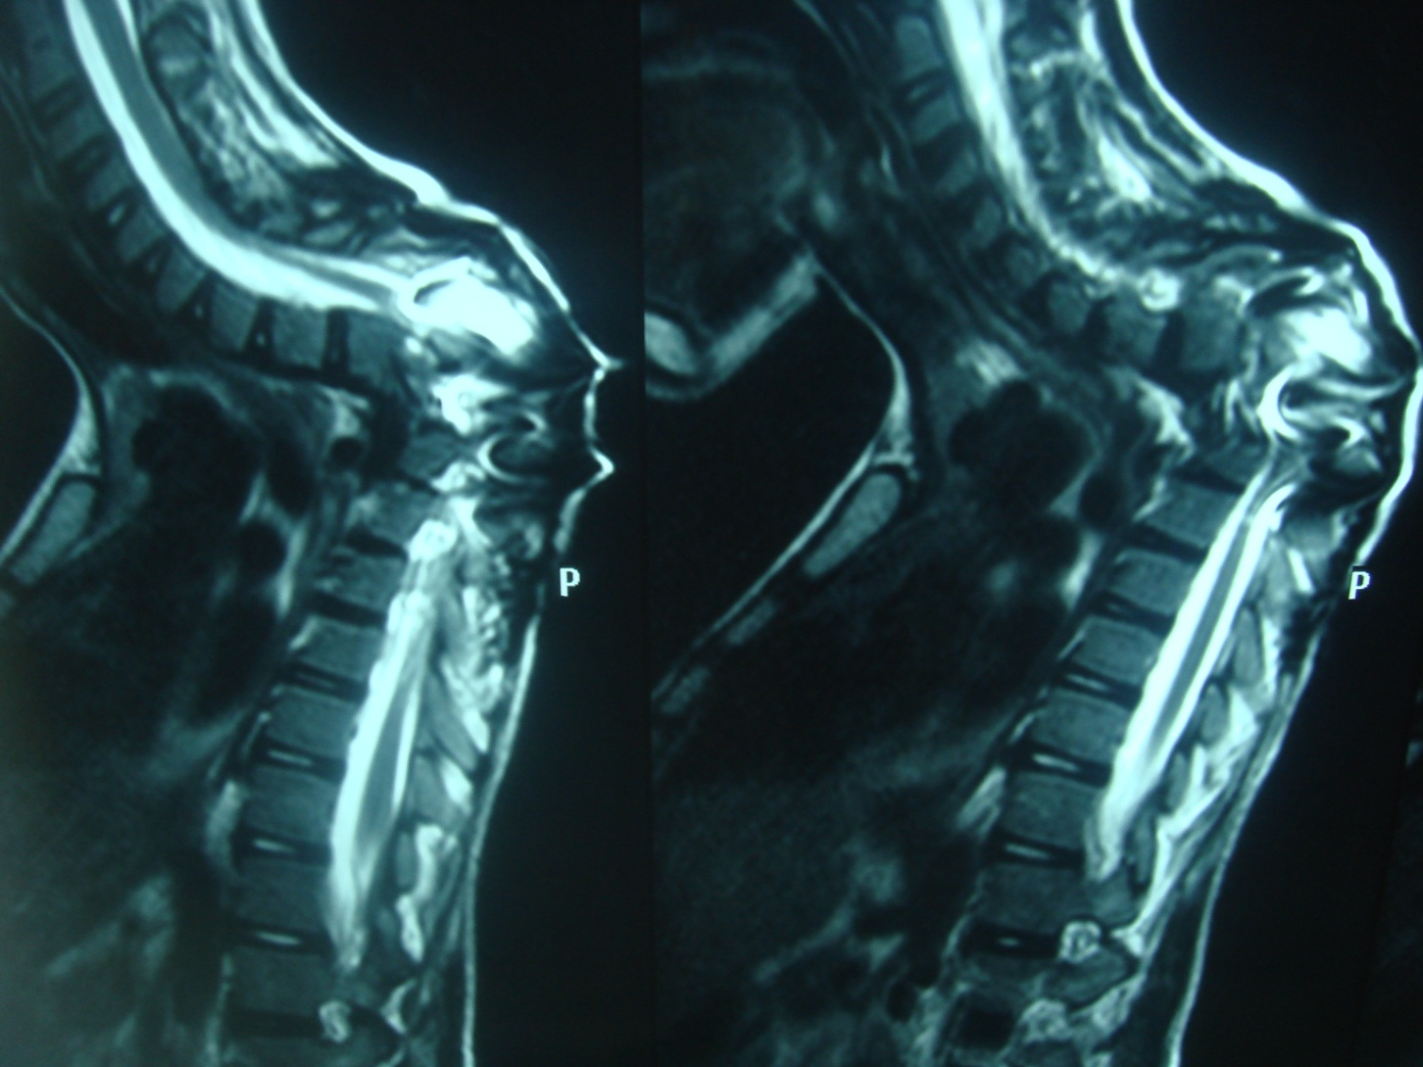
SAGGITAL PLANE DEFORMITY

Slide 9
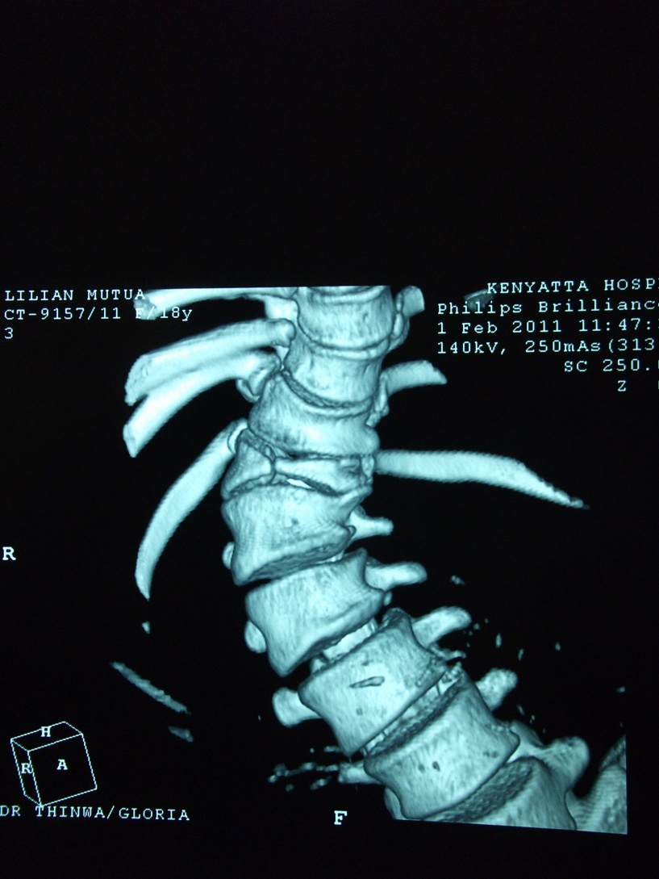
TRIPLANAR DEFORMITY/ 3D

Slide 10
SCOLIOSIS
Scoliosis (from Greek: skolíōsis meaning "crooked")
Curvature mainly in the coronal plane as well as sagittal plane (hypolordosis) → shaped like an “S" and is usually rotated → 3D Deformity
Hypolordosis is the commonest saggital plane deformity.
SRS (Scoliotic research Society) → Scoliosis is a lateral curvature of the spine > 10º as measured using the Cobb method on a standing radiograph.
Depending on populations 0.1- 3 % of the population, 1 % of these will require surgery.
Notes:
The characteristics of Adolescent Idiopathic Scoliosis include a __________________
Most idiopathic curves are lordotic or hypokyphotic in the thoracic region
A knowledge of the natural history and prevalence of Adolescent Idiopathic Scoliosis is essential to determine if treatment is necessary.
Three important questions need to be answered:
1. What is the prevalence of idiopathic scoliosis in the general population? 2. What is the likelihood of curve progression necessitating treatment in a child with scoliosis? 3. What problems may occur in adult life if scoliosis is left untreated and the curve progresses?
Once scoliosis has been discovered in a child, the curve must be evaluated for the probability of progression.
Most authors define progression as an increase of 5 degrees or more measured by the Cobb measurement over two or more visits.
What is unknown is whether this progression will continue and what the final curve will be.
Spontaneous improvement can occur in 3% of adolescents with idiopathic scoliosis, most of whom have curves of less than 11 degrees.
Certain factors have been found to be related to curve progression (Box 38-2).
Progression is more likely in girls than in boys.
The time of curve progression in adolescent idiopathic scoliosis generally is during the rapid adolescent growth spurt before the onset of menses.
The incidence of progression decreases as the child gets older.

Slide 11
CLASSIFICATION OF SCOLIOSIS
Postural
Secondary or Compensatory to condition outside the spine.
Non Structural and non progressive
Examples →
Short Leg
Pelvic tilt (hip contracture)
Prolapsed Disc
Structural
Condition affecting primarily spine
Non correctable and may be progressive
Structural
Secondary (compensatory) curves emerge to counterbalance primary deformity.
Severe deformity → Cardiopulmonary function affected

Slide 12
AETIOLOGY
Idiopathic (70-80)%
Usually a diagnosis of exclusion
Congenital Causes
Failure of formation
Failure of Segmentation
Combination
Neuropathic/ Myopathic disorders
Tethered cord syndrome*
Syringomyelia
Spinal tumor
Neurofibromatosis
Muscular dystrophy
Cerebral palsy
Poliomyelitis
Friedreich’s ataxia
Familial dysautonomia
(Riley-Day syndrome)
Werdnig-Hoffmann disease
Inherited disorders of connective tissue
Ehlers-Danlos syndrome
Marfan syndrome
Homocystinuria
Notes:
CONGENITAL CAUSES
FAILURE OF FORMATION → SOME PART OF THE SPINE IS NOT FORM; THE UNFORMED SIDE GOES INTO CONCAVITY
FAILURE OF SEGMENTATION OF SOMITES → TETHERED TOGETHER

Slide 13
OTHERS
Musculoskeletal
Leg length discrepancy
Developmental dysplasia of the hip
Osteogenesis imperfecta
Trauma
One side of the spine is affected more than the others
Infective
E.g. Gibbous deformity
Degenerative
Iatrogenic

Slide 14
IMPORTANT TERMINOLOGIES
Upper End Vertebra
The most superior vertebrae included in the curve of the scoliosis
Lower End Vertebra
The most inferior vertebrae included in the curve of the scoliosis
Apex Vertebra
Determines location of Curve
T1→T11 :- Thoracic scoliosis
T12 → L2 :- Thoraco- Lumbar scoliosis
Below L2 :– Lumbar scoliosis

Slide 15
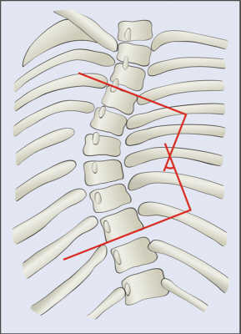
COBB’S ANGLE MEASUREMENT
Draw a line parallel to the upper end plate of the upper end vertebrae
Draw a line parallel to the lower end plate of the lower end vertebrae
Where both lines meet → Cobb’s angle → describes the magnitude of the curvature
Drop perpendiculars from both lines and the acute angle formed where the perpendiculars meet is similar to the Cobbs angle.

Slide 16
IDIOPATHIC SCOLIOSIS
Idiopathic scoliosis is a structural curve with no clear underlying cause.
Diagnosis → exclusion diagnosis
Accounts for 70-80 % causes of scoliosis

Slide 17
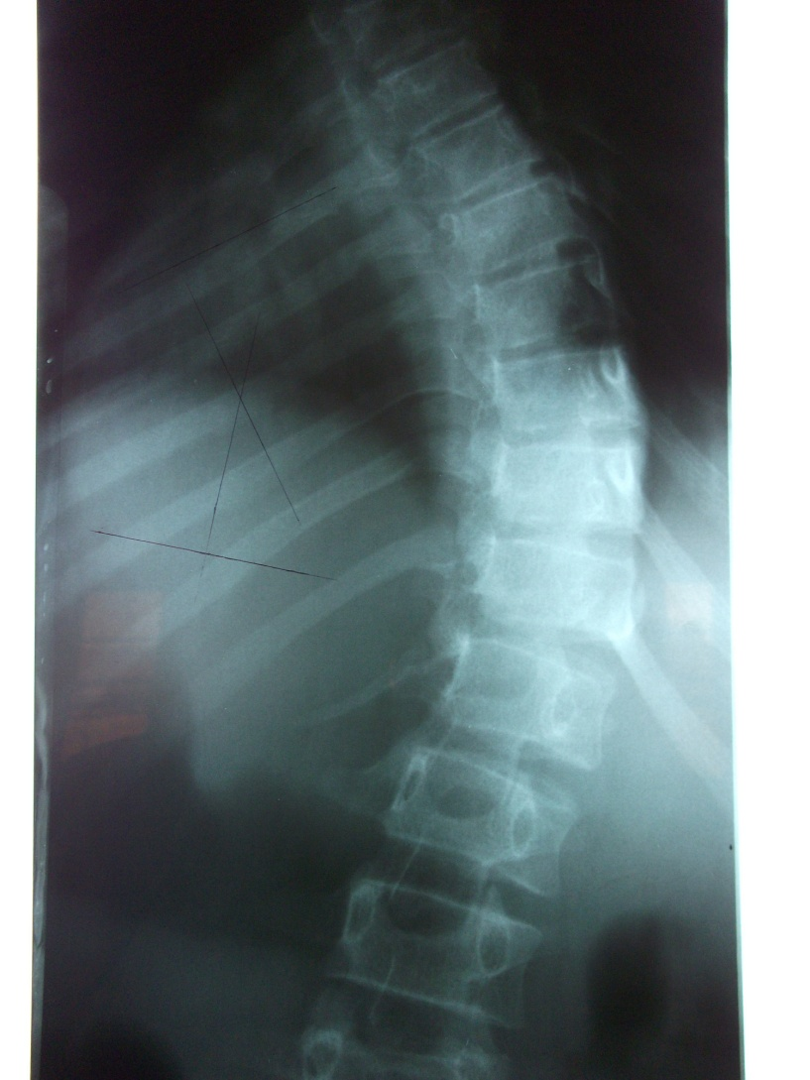
IDIOPATHIC SCOLIOSIS

Slide 18
CLASSIFICATION OF IDIOPATHIC SCOLIOSIS
Age
Infantile → < 4 years
Juvenile → 4- 10 years
Adolescent → > 10 years
Sub-classification
Curve Location
Thoracic
Thoracolumbar
Lumbar
Curve Convexity
Right
Left
Curve pattern
Kings Classification
Lenke Classification

Slide 19
PATHOPHYSIOLOGY
Thought to be a multigene dominant condition with variable phenotypic Expression.
The risk for scoliosis greater in monozygotic twins than in dizygotic twins.
The rate of curve progression is nearly identical among twins subjected to a variety of environmental influences.
When both parents have scoliosis, the risk that their children will require treatment is 50 times that in the general population.
Notes:
Many studies have attempted to uncover the pathophysiologic process underlying idiopathic scoliosis.
Multiple abnormalities have been found, yet none has been conclusively linked to all cases.
Therefore, even though scoliosis is typically present in most members of the same family, its severity can vary widely from parent to child and sibling to sibling.
Studies of twins have given the firmest indication that the most significant factor is genetic.

Slide 20
INFANTILE IDIOPATHIC SCOLIOSIS
Onset before Four years of age.
Accounts for < 1 percent of all cases.
More frequent in boys than in girls.
Primarily thoracic and convex to the left.
Postulated to result from lying on the Right Lateral Position
McMaster (Edinburgh) no scoliosis in infants nursed prone
Infantile scoliosis may be
Progressive, usually increasing rapidly, OR resolve spontaneously
The resolving type occurs in 70% to 90% of patients
Curves more than 37 ° Cobb’s angle when first seen → scoliosis probably is progressive.
Mehta developed a method to differentiate resolving from progressive curves in infantile idiopathic scoliosis based on measurement of the rib-vertebral angle (RVA).
[RVA > 20° → progressive]
Treatment options include serial casting
Subcutaneous instrumentation without fusion
Notes:
If the common pattern is altered in a presenting patient e.g. a girl with scoliosis of a convexity to the right → investigate further for cause

Slide 21
JUVENILE IDIOPATHIC SCOLIOSIS
Appears between the ages of 4 and 10 years.
Convexity of the thoracic curve usually is to the right.
Occurs in 12 - 21 % of all patients with idiopathic scoliosis
Natural history more progressive than AIS
Lonstein
67% of patients younger than 10 years showed curve progression
Risk of progression 100% in curves of more than 20 degrees
High incidence of neural axis abnormalities, 26.7% of patients MRI abnormalities
Indications for MRI evaluation include
Pain,
Rapid progression,
Left thoracic deformity,
Neurological abnormalities → (alterations in the superficial abdominal reflex), and other neurological findings, such as loss of bowel or bladder control.
Treatment similar to adolescent idiopathic scoliosis
Notes:
Treatment
Although it is likely to progress and to require surgery, juvenile idiopathic scoliosis is treated according to guidelines similar to those for adolescent idiopathic scoliosis. For curves of less than 20 degrees, observation is indicated, with examination and standing posteroanterior radiographs every 4 to 6 months. Evidence of progression on the radiographs as indicated by a change of at least 5 to 7 degrees warrants brace treatment. If the curve is not progressing, observation is continued until skeletal maturity.
Although much of the literature concerning orthotic treatment of juvenile idiopathic scoliosis has emphasized the Milwaukee brace, a TLSO often is used for thoracic curves with the apex at T8 or below. Initially, the brace is worn full-time (22 of 24 hours). If the curve improves after at least 1 year of full-time bracing, the hours per day of brace wear can be decreased gradually to a nighttime-only bracing program, which is much more tolerable, especially when the child reaches puberty. However, the patient is carefully observed for any sign of curve progression during this weaning process. If curve progression is noted, a full-time brace program is resumed.
The success of nonoperative treatment is variable. In the series of Figueiredo and James, 44% of patients were successfully managed conservatively; 56% required spinal fusion. In Tolo and Gillespie's series, 27% of patients required surgical fusion for progressive curves. Tolo and Gillespie found that it was not possible to predict which curves would increase from the curve pattern, the degree of curvature, or the patient's age at the time of diagnosis. Although they found the initial RVAD measurement to be of only limited value, serial measurements were useful to evaluate brace treatment. Several guidelines can be formulated for evaluating brace treatment (Box 38-1).
Box 38-1
Evaluation of Brace Treatment of Juvenile Idiopathic Scoliosis by the RVAD If the RVAD progresses above 10 degrees during brace wear, progression can be expected. If the RVAD values decline as treatment continues, part-time Milwaukee brace wear should be adequate. Those curves with RVAD values near or below 0 degrees at the time of diagnosis generally will require only a short period of full-time brace wear before part-time brace wear is begun.
Tolo and Gillespie recommended that evidence of progression be obtained before a Milwaukee brace is applied, unless the curve is greater than 30 degrees when the juvenile patient is first seen, because some curves, even in the range of 20 to 30 degrees, did not progress during a period of several months. Mannherz et al. confirmed that the RVAD was helpful in predicting progression in most juvenile idiopathic scoliosis curves. The initial RVAD was not helpful, but progressive RVAD to greater than 10 degrees over time was associated with curve progression. A higher incidence of curve progression also was noted in patients with less than 20 degrees of thoracic kyphosis. Double major curves tended to progress most often.
Kahanovitz, Levine, and Lardone found that patients with curves of less than 35 degrees and RVADs of less than 20 degrees had excellent prognoses with treatment in a part-time Milwaukee brace program. Patients with curvatures of greater than 45 degrees at the onset of bracing and whose RVADs exceeded 20 degrees all eventually underwent spinal fusion. Patients with curvatures from 35 to 45 degrees at the onset of bracing had much less predictable prognoses. The part-time brace program consisted of wearing the brace after school and all night for approximately a year. The patients were then kept in the brace at night only for another 2.5 years. The brace was at that point worn every other night for an average of 1.2 years. Bracing generally was discontinued completely at an average of about 14 years of age. Individually, however, the numbers of hours spent wearing the brace depended on the amount of improvement and stability of the curvature. Part-time brace treatment may afford these children the social and psychological benefits not provided by a full-time Milwaukee brace program. The Milwaukee brace may be preferred because it does not cause chest wall compression in these young patients. A total-contact TLSO often is prescribed, but rib cage distortion is possible because of the lengthy time the child must wear the brace. Early reports of the part-time Charleston bending brace were encouraging, but its usefulness has not been established (see the section on orthotic treatment of adolescent idiopathic scoliosis).
Even if the curve progresses, bracing may slow progression and delay surgery until the child is older, which may avoid a short trunk and lessen the possibility of a crankshaft phenomenon. If orthotic treatment fails, either a subcutaneous rod or multihook segmental system or spinal fusion should be considered. If the child is younger than 8 years and small, the ideal treatment is subcutaneous rod insertion, with or without an anterior apical growth arrest procedure. If the child is larger and 9 or 10 years of age, fusion may be appropriate, but combined anterior and posterior spinal fusions should be considered to avoid a crankshaft phenomenon.
Dimeglio found that during the first 5 years of life, the spine from T1 to S1 grows more than 2 cm a year. Between the ages of 5 and 10 years, it grows 0.9 cm a year, and then 1.8 cm a year during puberty (Fig. 38-3). In 24 children with infantile or juvenile idiopathic scoliosis, Hefti and McMaster found that a solid spinal fusion stopped the longitudinal growth in the posterior elements, but the vertebral bodies continued to grow anteriorly. The anterior growth causes the vertebral bodies and discs to bulge laterally toward the convexity and to pivot on the posterior fusion, causing loss of correction, increase in vertebral rotation, and recurrence of the rib

Slide 22
ADOLESCENT IDIOPATHIC SCOLIOSIS
Occurs between age 10 and skeletal maturity.
Accounts for the majority of cases of idiopathic scoliosis→ 80-90 %
Present in 2 to 4 % of children 10 and 16 years affecting mainly girls
M: F ratio of small curves upto 10 degrees is equal, but increases to a ratio of 10 :1 in curves greater than 30degrees.
Scoliosis in girls tends to progress more often and, therefore, girls more commonly need treatment than boys.
The prevalence of curves greater than 30 degrees is approximately 0.2 percent, and the prevalence for curves greater than 40 degrees is approximately 0.1 percent.

Slide 23
CURVE PROGRESSION DETERMINANTS
Main determinants of progression are
Patient gender → In all cases, females have a risk of curve progression 10 times higher than males
Future growth potential
The curve magnitude at the time of diagnosis
The greater the growth potential and
The larger the curve, the greater the likelihood of curve progression.

Slide 24
PROGRESSION VS CURVE PATTERNS/ SEVERITY.
Curve Pattern
Double curves are more likely to progress than single curves,
Single thoracic curves more progressive than single lumbar curves.
Curve Severity
Bunnell estimated that the risk of progression for a 20º curve is approximately 20% and the risk for a 50º curve is 90%.

Slide 25
GROWTH POTENTIAL EVALUATION
Evaluation of growth potential is done by assessing the Tanner stage and the Risser grade.
Tanner stage 2 to 3 → Occurs just after the onset of pubertal growth spurt and is the time of maximum progression of scoliosis.
The Risser grade (zero to 5) → Gives a useful estimate of how much skeletal growth remains by grading the progress of bony fusion of the iliac apophysis. The lower the grade the more immature the patient.
Notes:
Tanner stage 2 to 3 occurs just after the onset of the pubertal growth spurt and is the time of maximum progression of scoliosis.
The iliac apophysis ossifies in a predictable fashion from anterolateral to posteromedial along the iliac crest.
The risk of curve progression can be estimated by taking into account the patient’s sex, time of menarche and growth potential
(Tanner stage and Risser grade), and the magnitude of the curve.
This is key information to help with decisions about the need for referral to an orthopedic surgeon and, in those who are not referred, about examination
frequency for curves at lower risk of progression.

Slide 26
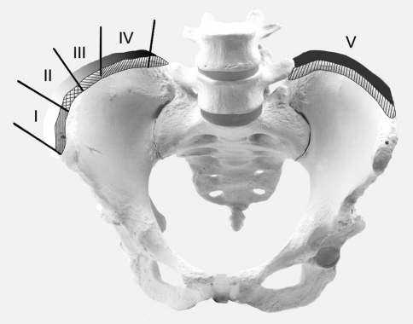
RISSER GRADING

Slide 27
NATURAL HISTORY
Back pain, no df → ↑incidence of frequency, ↑ lumbar &TL curves esp. those with translatory shifts low end of the curve
Pulmonary function → Thoracic, Restrictive, Smokers, significant limitation FVC ->100°
Psychosocial effects → 20% females with curves >40° adulthood, social isolation, limited job opportunities and lower marriage rates
Mortality → No Difference
Curve progression → after skeletal maturity
< 30° → no progression
30° → 50° progress 10-15° lifetime
> 50° → progress 1° per year
Notes:
The incidence of back pain in the general population is between 60% and 80%, and the incidence in patients with idiopathic scoliosis is comparable. Weinstein et al., in a long-term follow-up study of more than 40 years, found that 80% of scoliotic patients complained of some backache. In a control group of 100 patients who were age and sex matched and did not have scoliosis, 86% reported backache. The incidence of frequent daily backache was slightly higher in the scoliosis group than in the control group. Patients with lumbar or thoracolumbar curves, especially those with translatory shifts at the lower end of the curves, had a slightly greater incidence of backache than did patients with other curve patterns; the backache in this population was never disabling and was unrelated to the presence of osteoarthritic changes on radiographic examination. Back pain rarely was disabling in any patient with scoliosis, although it was more severe than in adults without scoliosis.
Weinstein et al. found that pulmonary function was affected only in patents with thoracic curves; a direct correlation was found between decreasing vital capacity and increasing curve severity. The pulmonary problem was uniformly restrictive lung disease. Smokers were affected much more severely than nonsmokers. Significant limitations of forced vital capacity in nonsmokers did not occur until the curve approached 100 to 120 degrees.

Slide 28
CONGENITAL SCOLIOSIS (OSTEOPATHIC)
It is caused by vertebral anomalies present at birth e.g.
Failure of Formation – Hemivertebra
Failure of Segmentation
A combination of both

Slide 29
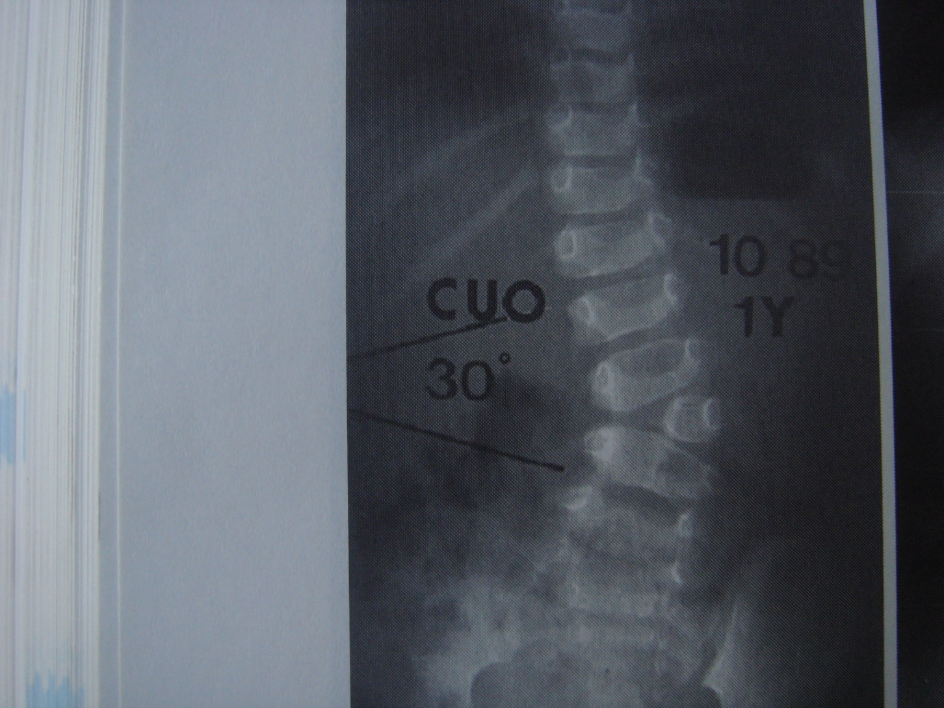
FAILURE OF FORMATION

Slide 30
FAILURE OF FORMATION

Slide 31
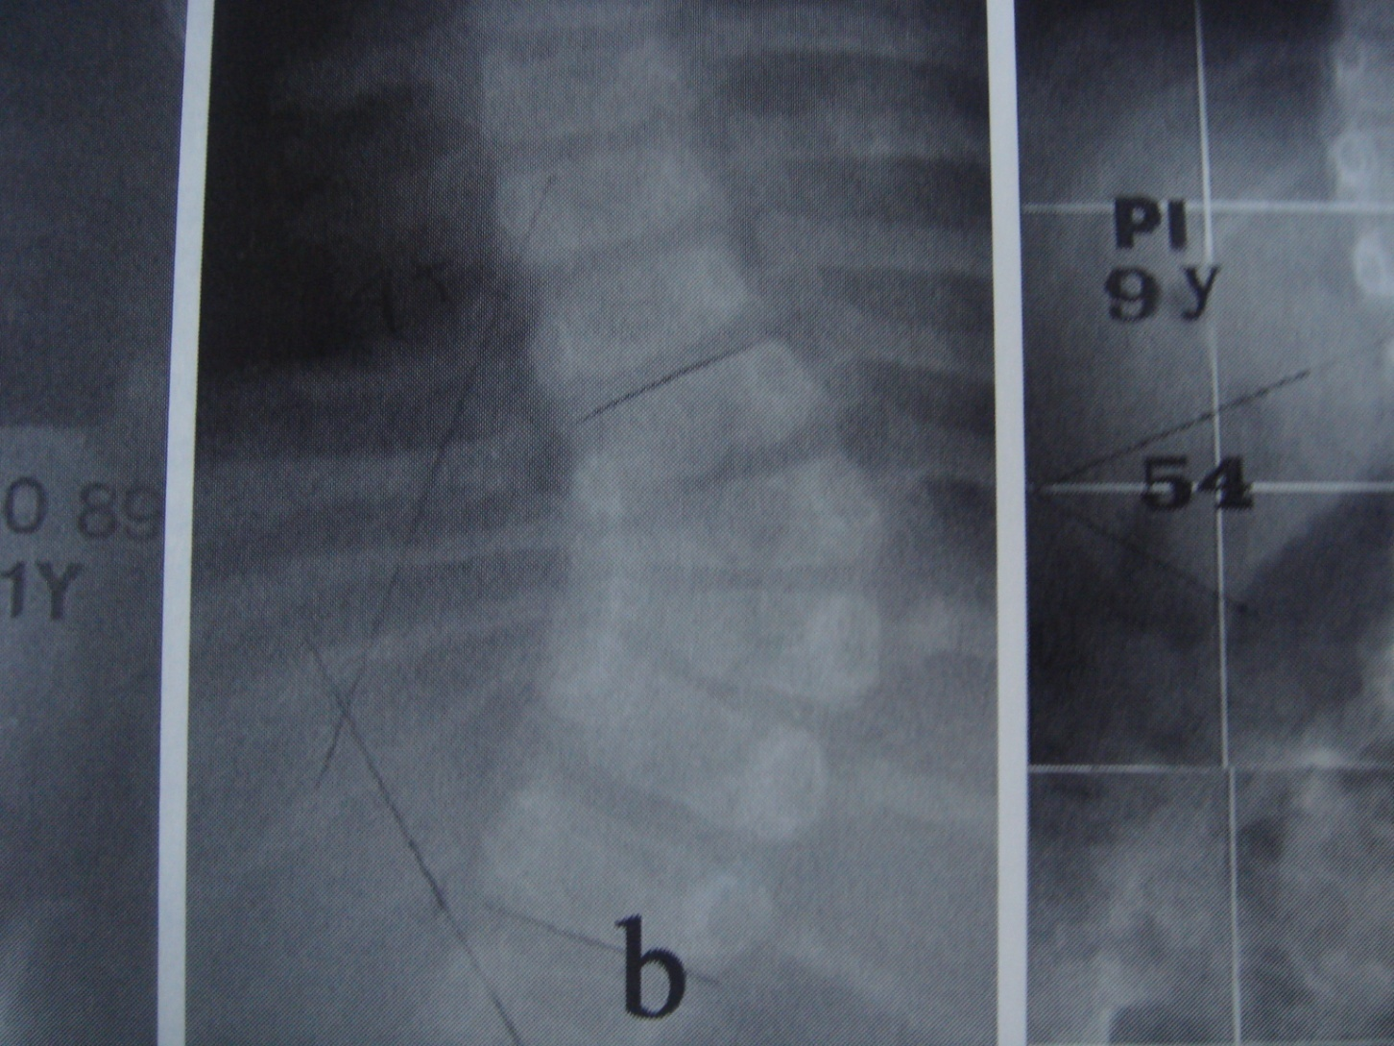
FAILURE OF SEGMENTATION
Notes:
A bar is formed that tethers the bones together

Slide 32
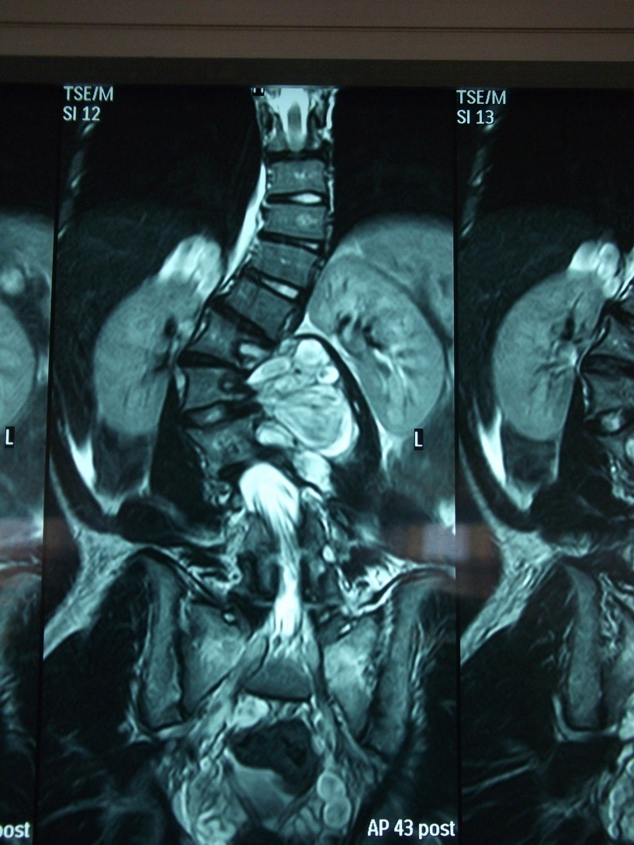
OTHER (NEUROFIBROMATOSIS) CAUSES

Slide 33
KYPHOSIS

Slide 34
INTRODUCTION
Kyphosis is the normal sagittal contour of the thoracic and sacral spine.
As a pathologic entity, kyphosis is an accentuation of this normal curvature.
Kyphosis can occur as a deformity solely in the sagittal plane, or it can occur in association with an abnormality in the coronal plane, resulting in kypho-scoliosis.

Slide 35
ETIOLOGY
Scheuermann disease
Postural round back
Congenital abnormalities, such as failure of formation or failure of segmentation of the spinal elements
Ankylosing spondylitis
Trauma
Spinal tumor
Infection
Iatrogenic causes of kyphosis
laminectomy and irradiation –(incompetence of the anterior or posterior column)
Metabolic disorders - Osteoporosis

Slide 36
SCHEUERMANN KYPHOSIS
Scheuermann kyphosis defined → 5° of wedging over 3 consecutive vertebral segments.
Kyphosis occurs with more than 45º with lower and upper end plate irregularities with apparent loss of disc space.
Causes of Scheuermann disease is still imprecisely defined. Theories include:
Avascular necrosis of the apophyseal ring
Histologic abnormalities at the endplate
Disc Herniation
Osteoporosis
Mechanical factors affecting spinal growth
Genetic component
Affects Male or Female 12-15 years presenting with angular kyphosis of thoracic spine.
Compensatory cervical lordosis brings the head forward with accompanying tight hamstring muscles.

Slide 37
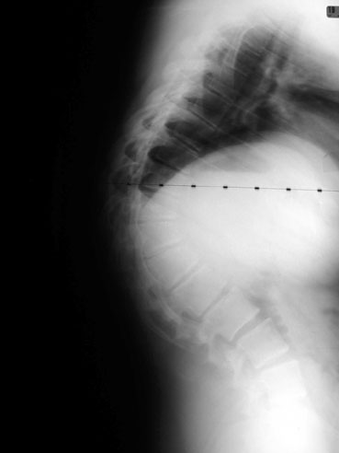
SCHEUERMANN KYPHOSIS

Slide 38
INDICATIONS OF BRACING (SK)
Extension Bracing indicated in
Curves 45-65 º with 2 years of growth remaining and more than 5 degrees wedging.

Slide 39
SURGICAL TREATMENT INDICATIONS
Unremitting pain
Neurologic changes
Progression of deformity
Cosmesis.
Proposed indications more specific than these are:
Kyphosis greater than 75°
Kyphosis greater than 65° with pain
An unacceptable appearance of the trunk in Scheuermann kyphosis
Problems with balance while sitting and skin problems due to pressure at the apex of the deformity

Slide 40
POSTURAL KYPHOSIS (ASTHENIC)
Postural kyphosis is present when accentuated kyphosis is observed without the characteristic 5° of wedging over 3 consecutive vertebral segments that defines Scheuermann kyphosis.
Thought to be due to muscular imbalance leading to the round-back appearance of these individuals

Slide 41
TYPES OF CONGENITAL KYPHOSIS
Failure of formation (Type I )
Failure of Segmentation (Type II)
Combination (Type III)

Slide 42
CONGENITAL KYPHOSIS

Slide 43
TREATMENT
Bracing has no role as congenital kyphosis does not respond to non-surgical treatment
Posterior fusion in situ or combined with anterior fusion

Slide 44
OTHERS
Traumatic
Infective
Achondroplasia
Metabolic (Osteoporosis)
Autoimmune (Ankylosing Spondylitis)
Iatrogenic

Slide 45
END

